Slide 1

ImageMedix
By Team 5 The Minions
Sprint 2

Slide 2
Agenda
Team Roles & Responsibilities
Improvements from Professor Feedback
Project Description
Team Working Agreement
Personas
MVP
Technologies and Algorithms
Diagrams
Product Backlog
Sprint 2 Backlog
Metrics
Retrospective
Sprint 3 Plan
Sprint 2 Demo
GitHub Repository
Live Application Demo

Slide 3
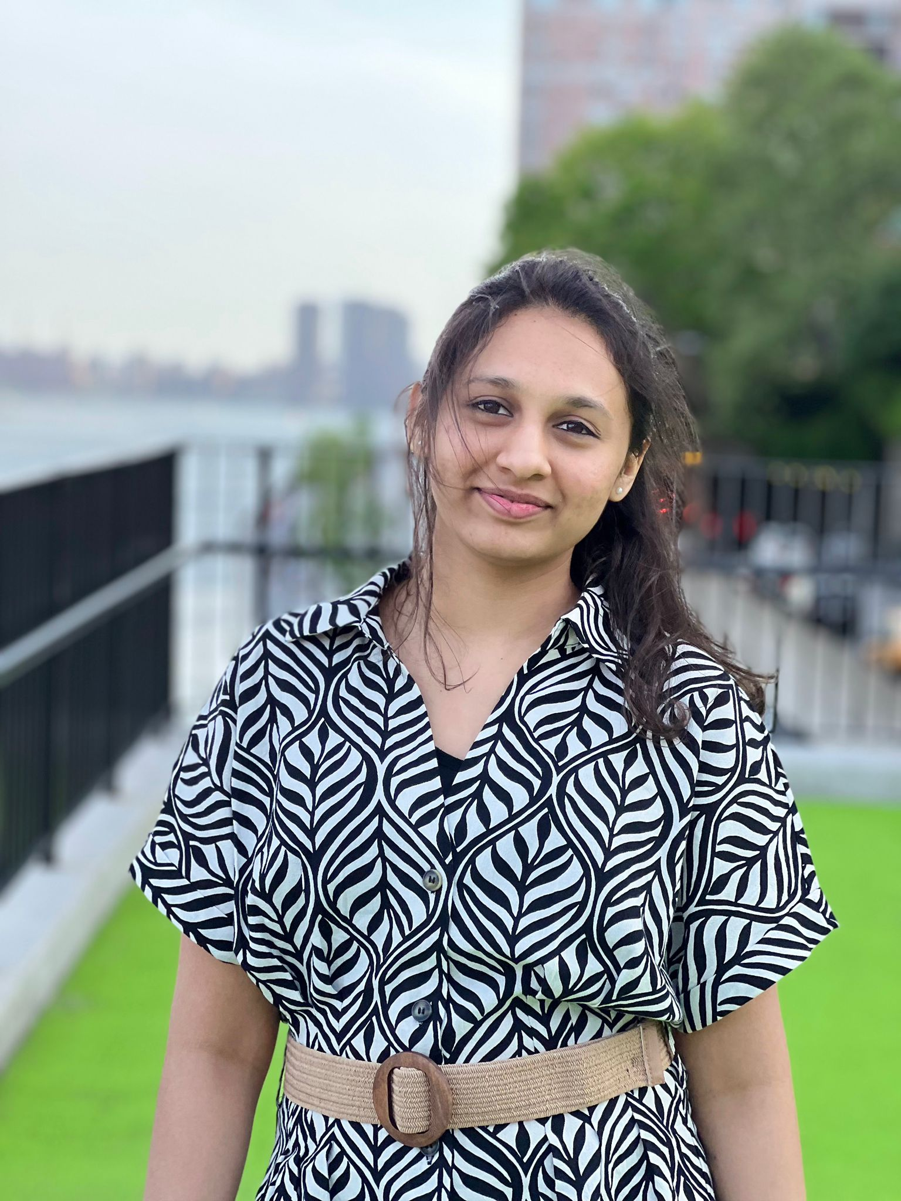
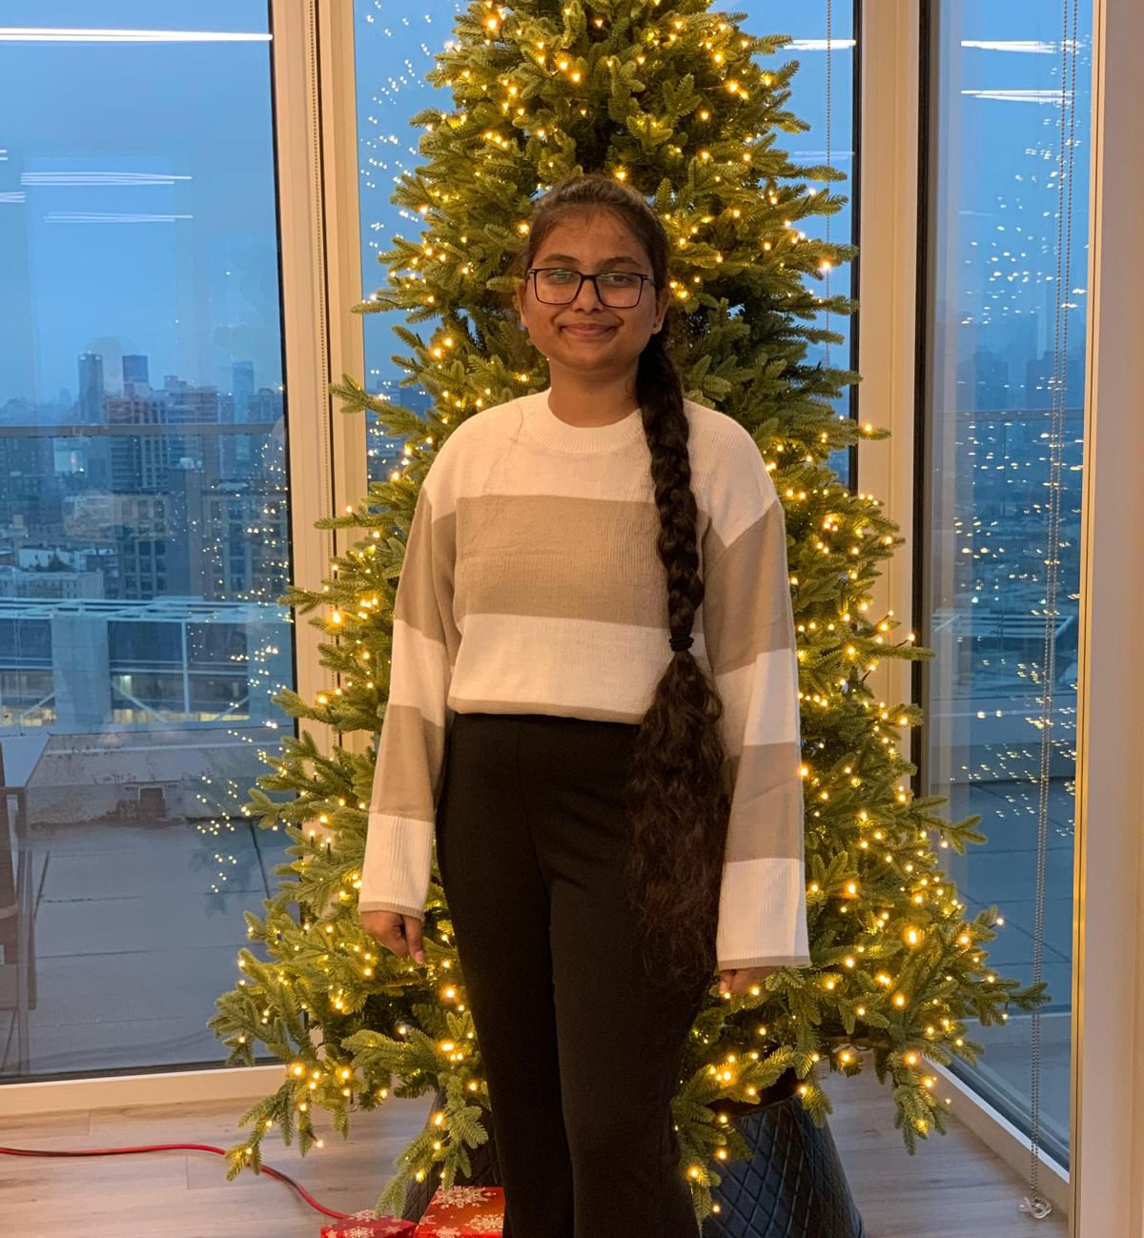

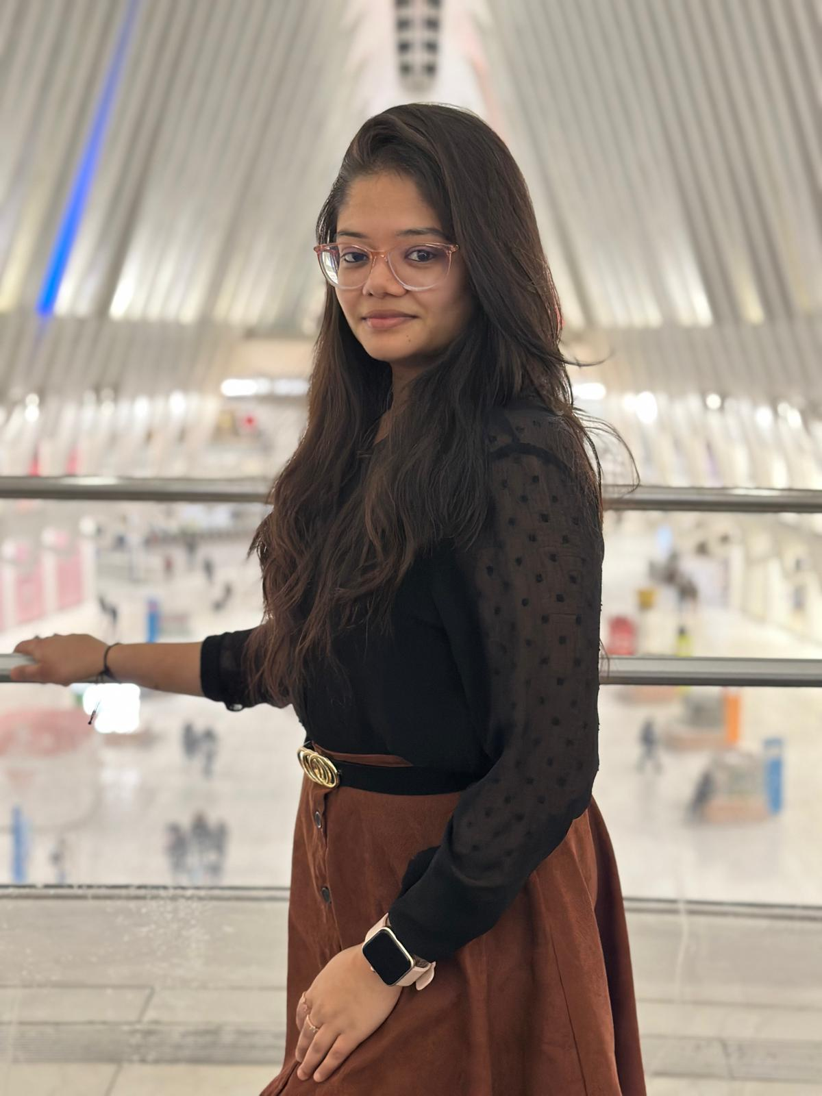
Team Members – machine learning
Vaishnavi Chandrasekar
Christiana Heden Kothuru
Deepika Mothkuri
Greeshma Kenche

Slide 4
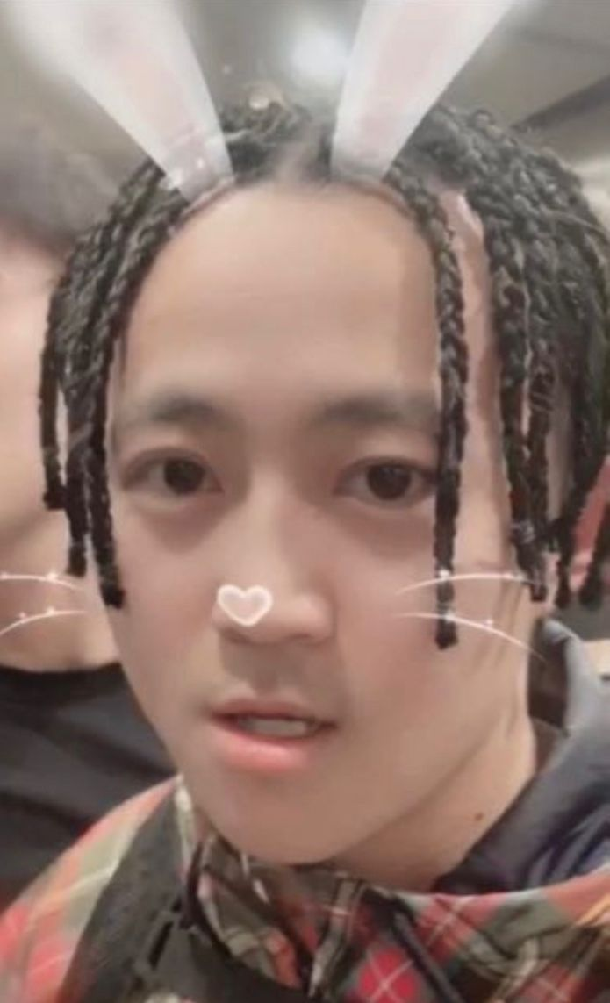
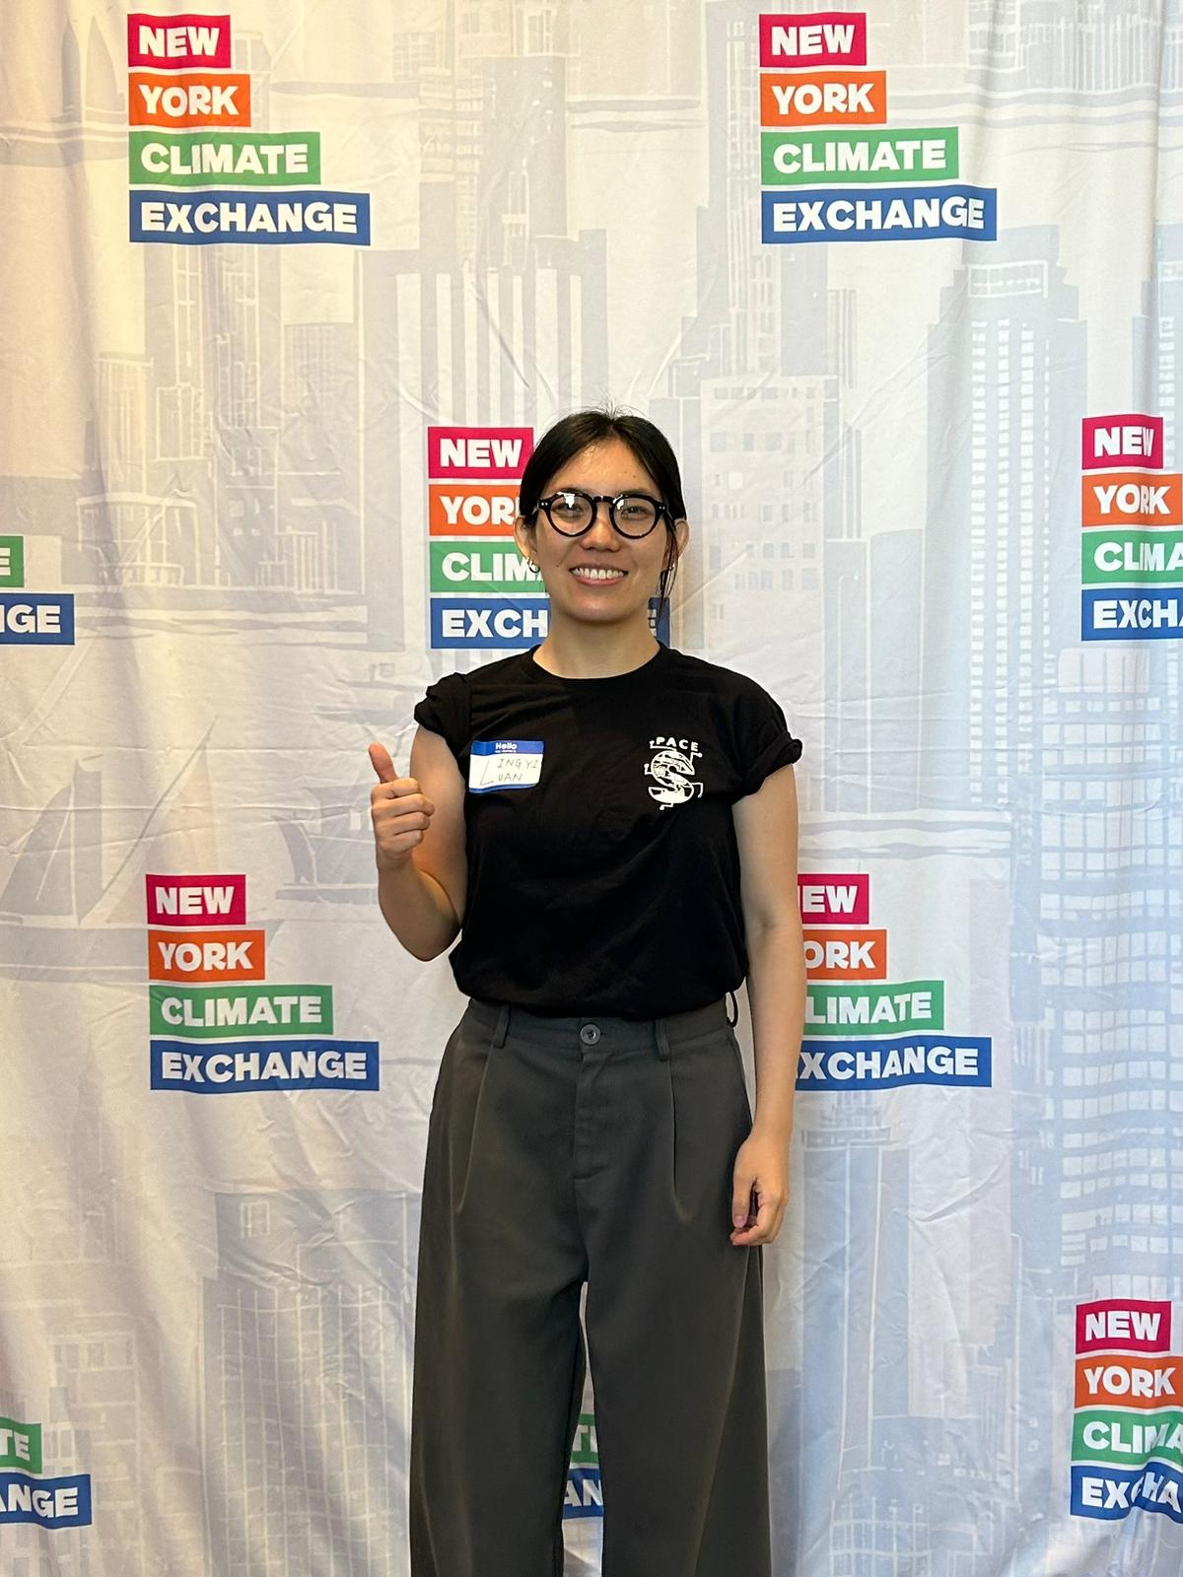
Team Members – Backend
Yucong Hu
Lingyi Luan

Slide 5

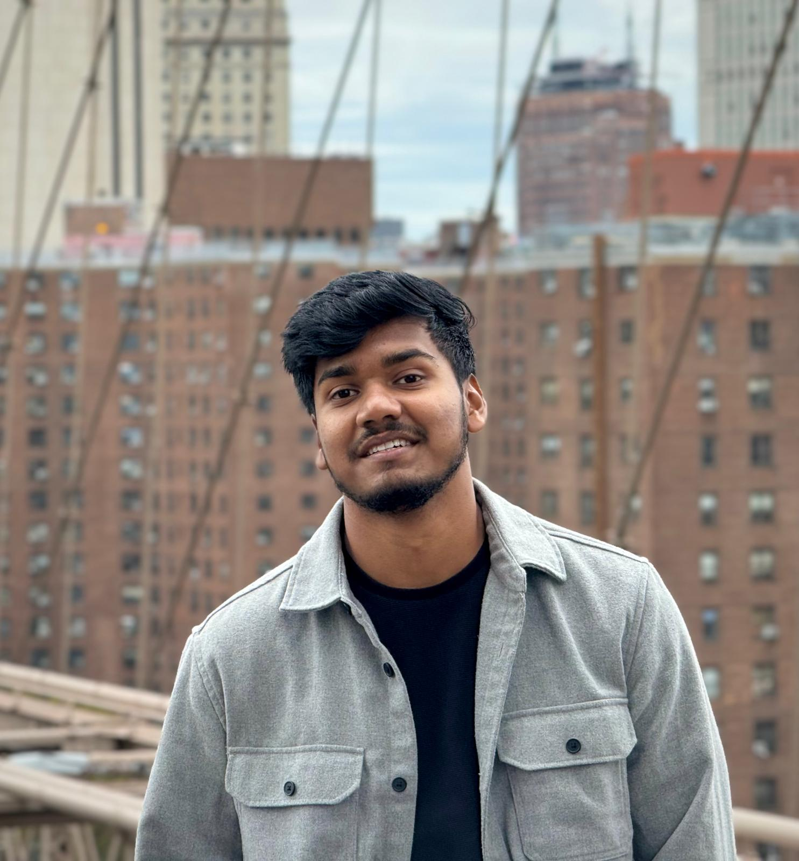
Team Members – Frontend
Yash Bhanubhai Panchani
Rameez Ahmed Shaik

Slide 6

Improvements
Change in the state diagram
Change in the acceptance criteria

Slide 7
Problem statement
Many healthcare facilities face challenges in diagnosing pneumonia and brain tumors quickly and accurately, often due to limited access to specialists and high workloads. Current solutions typically require separate systems to analyze different types of medical images. This leads to inefficiencies in diagnosis and delays in providing critical care. There is a need for an automated system that can efficiently classify medical images and provide preliminary diagnoses to support healthcare professionals in making timely decisions.

Slide 8
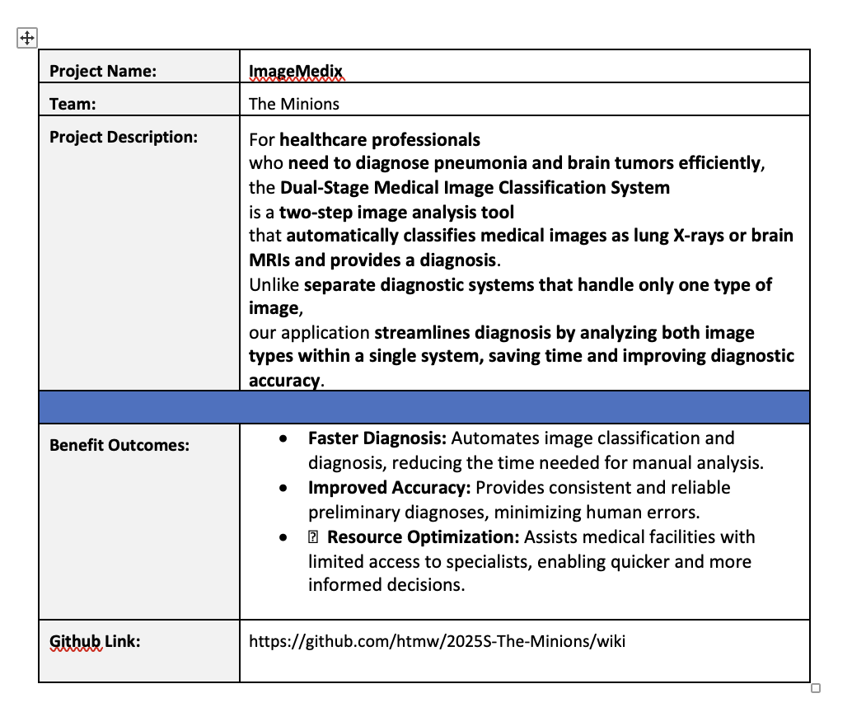
Project description

Slide 9
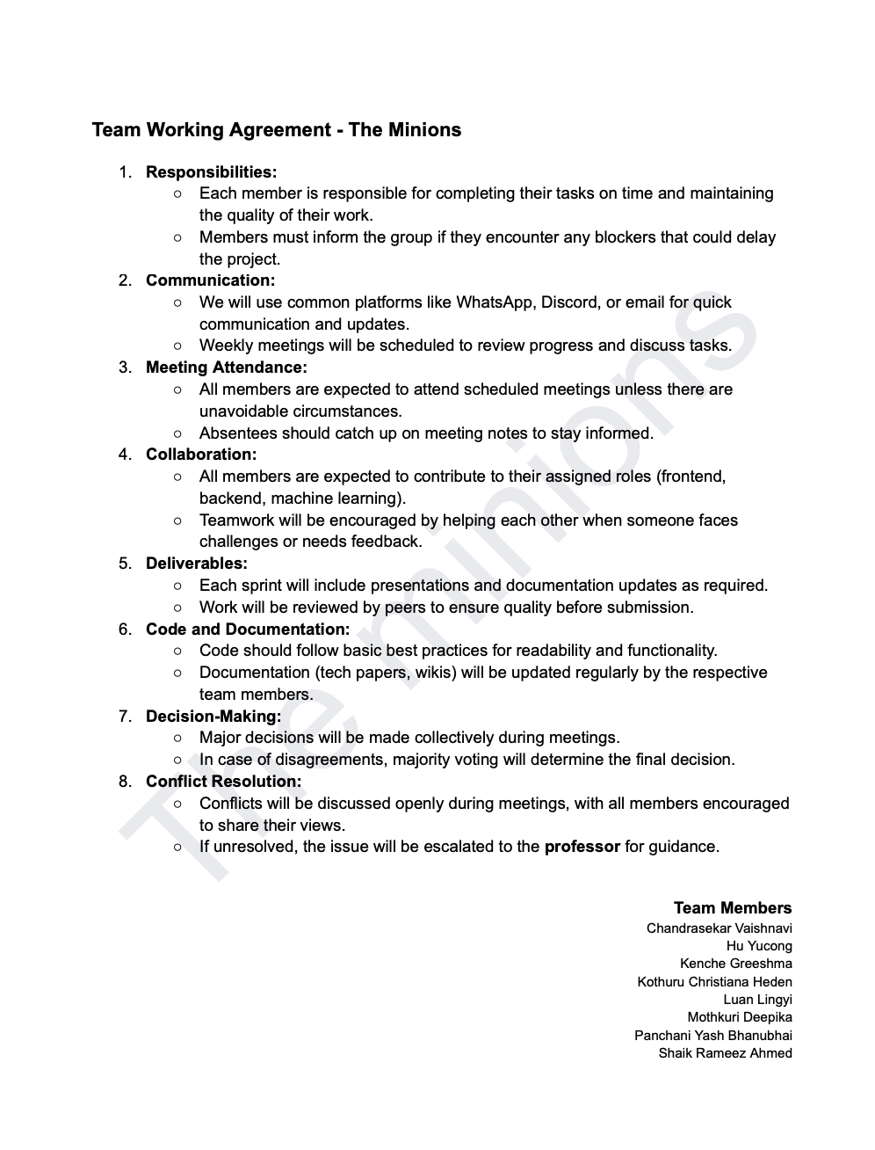
TEAM WORKING AGREEMENT

Slide 10
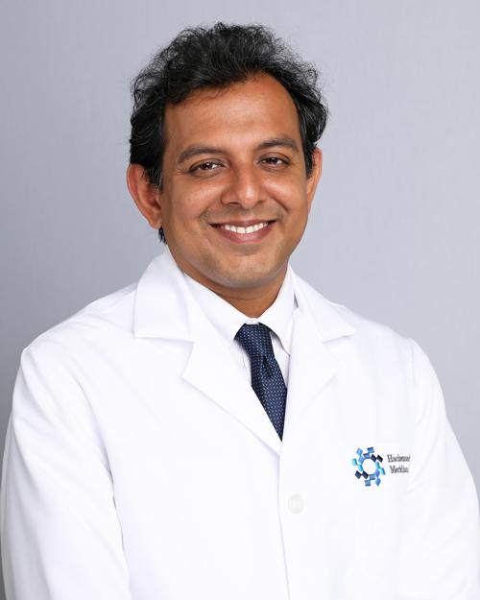
Personas
Dr. James Patel (Radiologist)
Age: 45
Occupation: Senior Radiologist at a metropolitan hospital
Background: Over 20 years of experience in diagnostic imaging, specializing in lung and brain disorders. Known for mentoring junior doctors in radiology.
Goals: To reduce the time spent analyzing large volumes of medical images while maintaining high diagnostic accuracy.
Challenges: Overloaded with image analysis requests and administrative duties, leading to delays in diagnosis and increased stress.
How the System Helps: Automates initial image classification and diagnosis, allowing Dr. Patel to prioritize critical and complex cases efficiently.

Slide 11

Personas
Dr. Suzen Chen (General Practitioner)
Age: 38
Occupation: General Practitioner at a rural healthcare clinic
Background: Has served in underserved regions for over a decade, often working without the immediate support of medical specialists. Committed to improving healthcare access in remote areas.
Goals: To provide fast, accurate diagnoses for patients despite limited access to specialists.
Challenges: She m ust handle a wide variety of cases on her own, making it difficult to diagnose complex conditions such as brain tumors and pneumonia accurately.
How the System Helps: The AI system offers reliable preliminary diagnoses for brain and lung conditions, helping Dr. Chen make timely and informed treatment decisions.

Slide 12

Personas
Dr. Raj Aryan (Healthcare Director)
Age: 50
Occupation: Director of a large hospital chain in India
Background: A visionary healthcare leader who has overseen the expansion of multiple hospitals across the country. Inspired by challenges faced in rural and semi-urban healthcare delivery.
Goals: To improve diagnostic efficiency, reduce patient wait times, and implement AI-based healthcare solutions across all branches.
Challenges: Delays in diagnosis caused by a shortage of skilled radiologists, leading to overcrowded hospitals and slow patient care.
How the System Helps: The automated system accelerates diagnosis processes across multiple hospitals, enabling faster and more efficient patient care, particularly in resource-constrained facilities.

Slide 13
MVP
Core Features
Two-Step Image Analysis
Classifies medical images as either lung X-rays or brain MRIs.
Provides automated diagnosis for pneumonia and brain tumors.
Automated Diagnosis System
Uses machine learning models to detect abnormalities.
Outputs a diagnostic result with confidence scores.
Unified Platform
Supports both lung X-rays and brain MRIs in a single system.
Eliminates the need for separate diagnostic tools.
User-Friendly Interface
Simple image upload functionality for healthcare professionals.
Displays classification results and diagnosis in an intuitive format.
Performance Metrics
Ensures accuracy through AI-driven predictions.
Optimized for faster diagnosis to reduce manual analysis time.
Basic Report Generation
Generates a preliminary diagnostic report.
Includes confidence levels and possible next steps for further medical review.

Slide 14






Technologies
Frontend: React.js
Used to create a user-friendly interface that allows healthcare professionals to upload and view medical images easily.
Backend: Node.js (API), Flask (Model Inference), MongoDB
Node.js: Handles API requests and manages communication between the frontend and backend services.
Flask: Supports model inference by running machine learning models for image classification and diagnosis.
MongoDB: Stores user data, images, and diagnostic results, enabling secure and scalable data management.
Machine Learning:
Built using PyTorch and trained on datasets for lung X-rays and brain MRIs.
Cloud Infrastructure:
Deployed using AWS.

Slide 15
Algorithms
The system uses two core algorithms based on pre-trained deep learning models. A ResNet model, fine-tuned on a dataset of medical images, is used to classify whether the uploaded image is a lung X-ray or a brain MRI. Depending on the classification result, the system proceeds to a second stage. For lung X-rays, a fine-tuned EfficientNet model detects and classifies pneumonia into normal, viral, or bacterial categories by analyzing lung patterns. For brain MRIs, the same EfficientNet model is used to detect and classify brain tumors into glioma, meningioma, or no tumor by identifying abnormalities in brain structures. These models provide high accuracy and efficiency, ensuring reliable diagnoses for both image types.

Slide 16
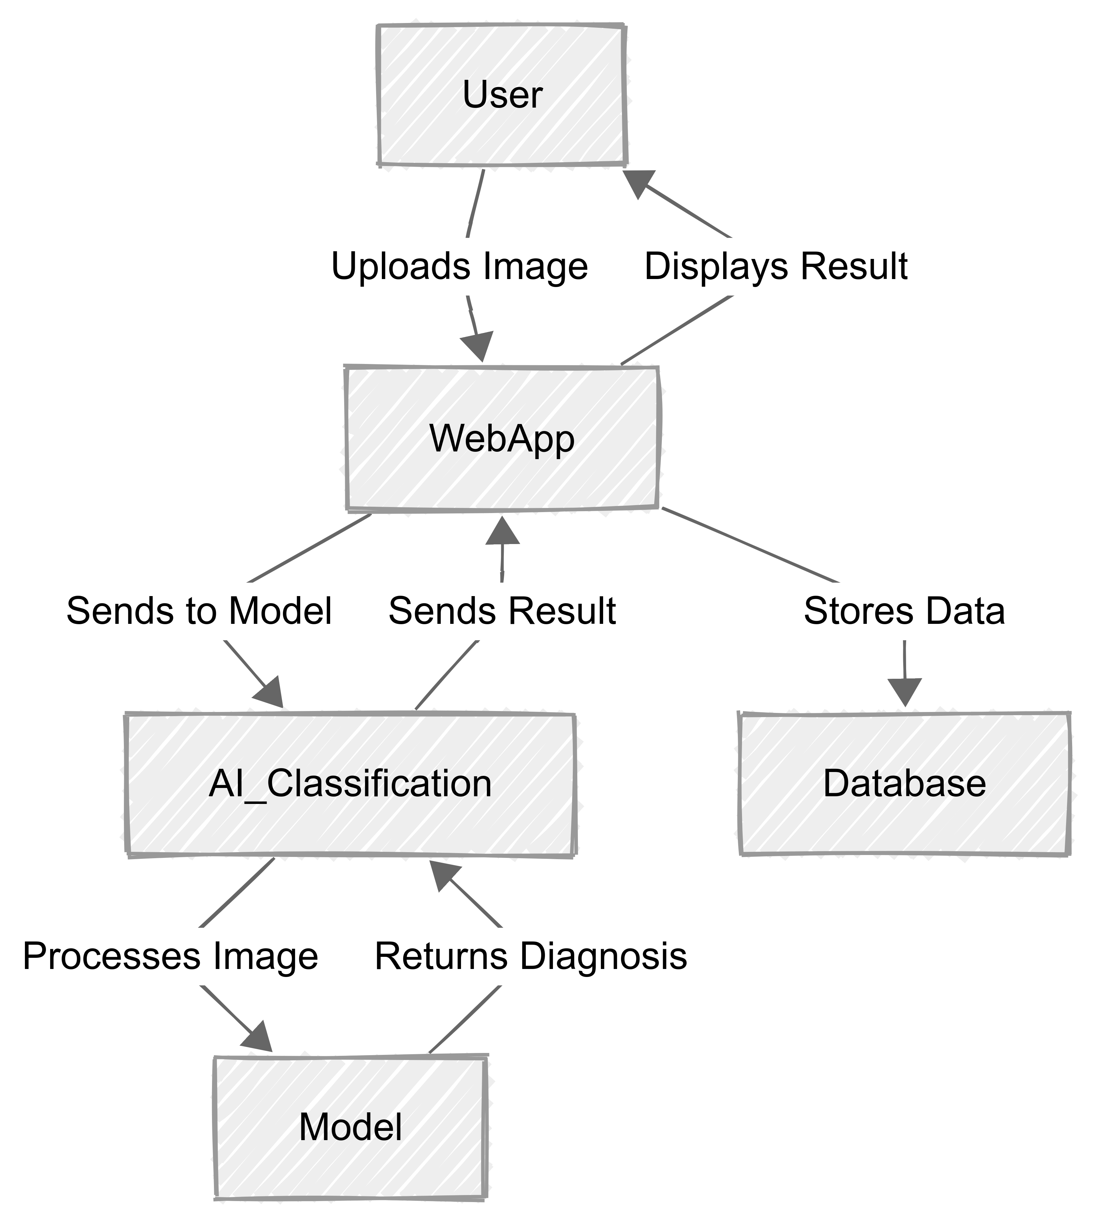
Architecture Diagram

Slide 17
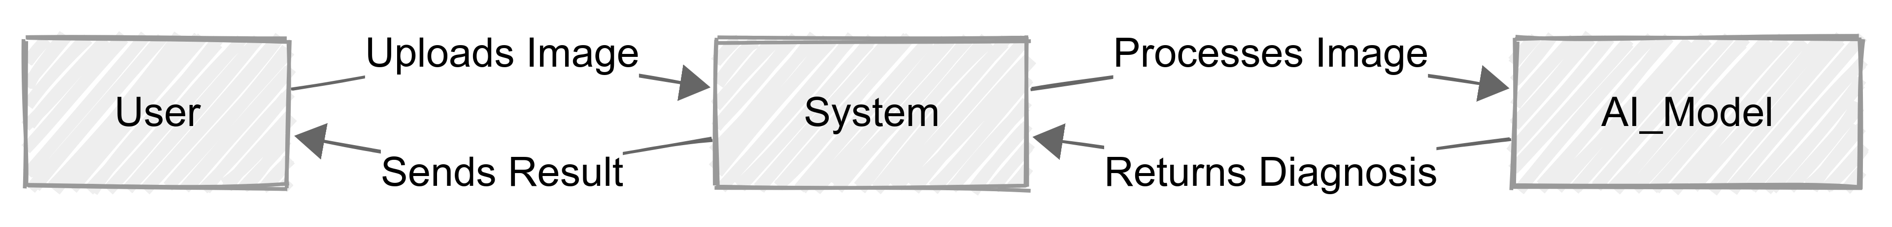
Context diagram

Slide 18
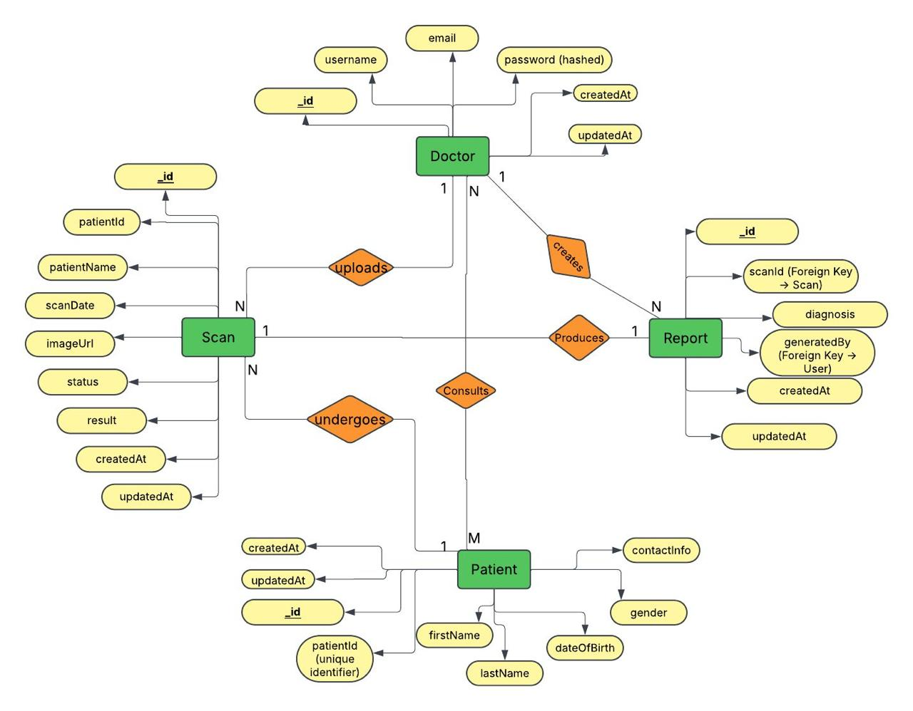
ER Diagram

Slide 19
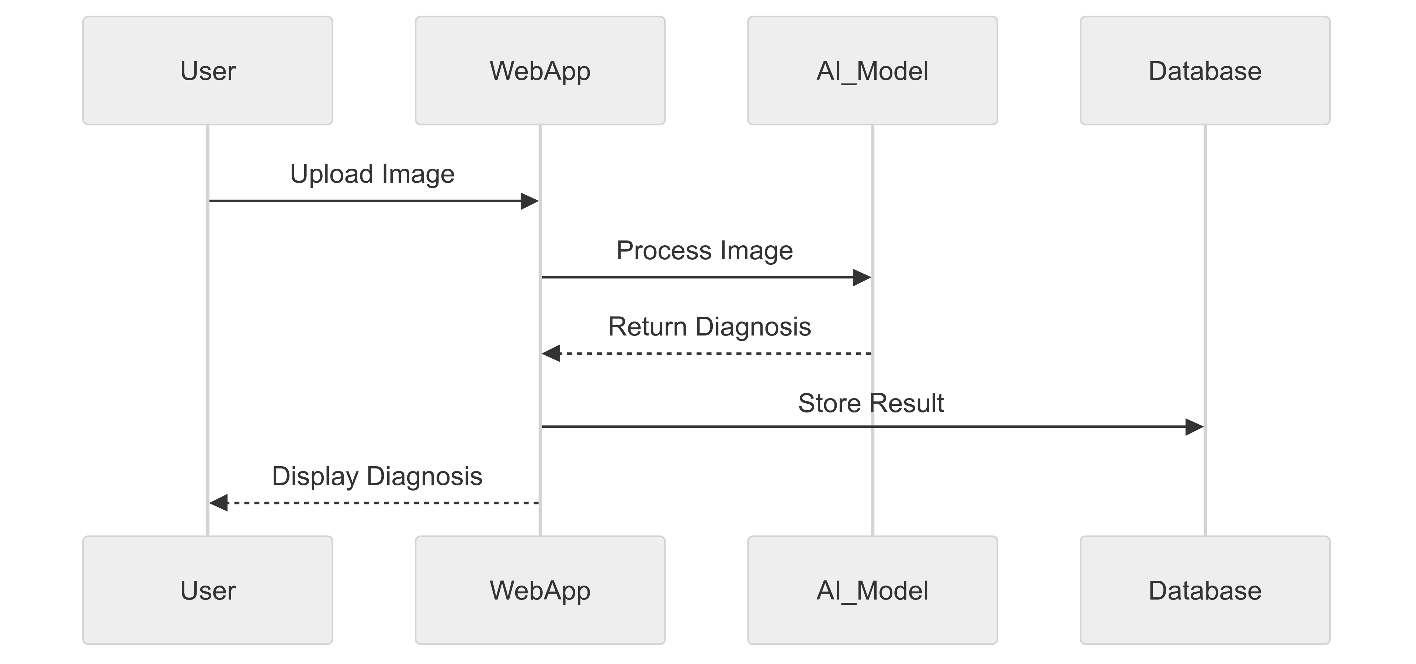
SEQUENCE DIAGRAM

Slide 20
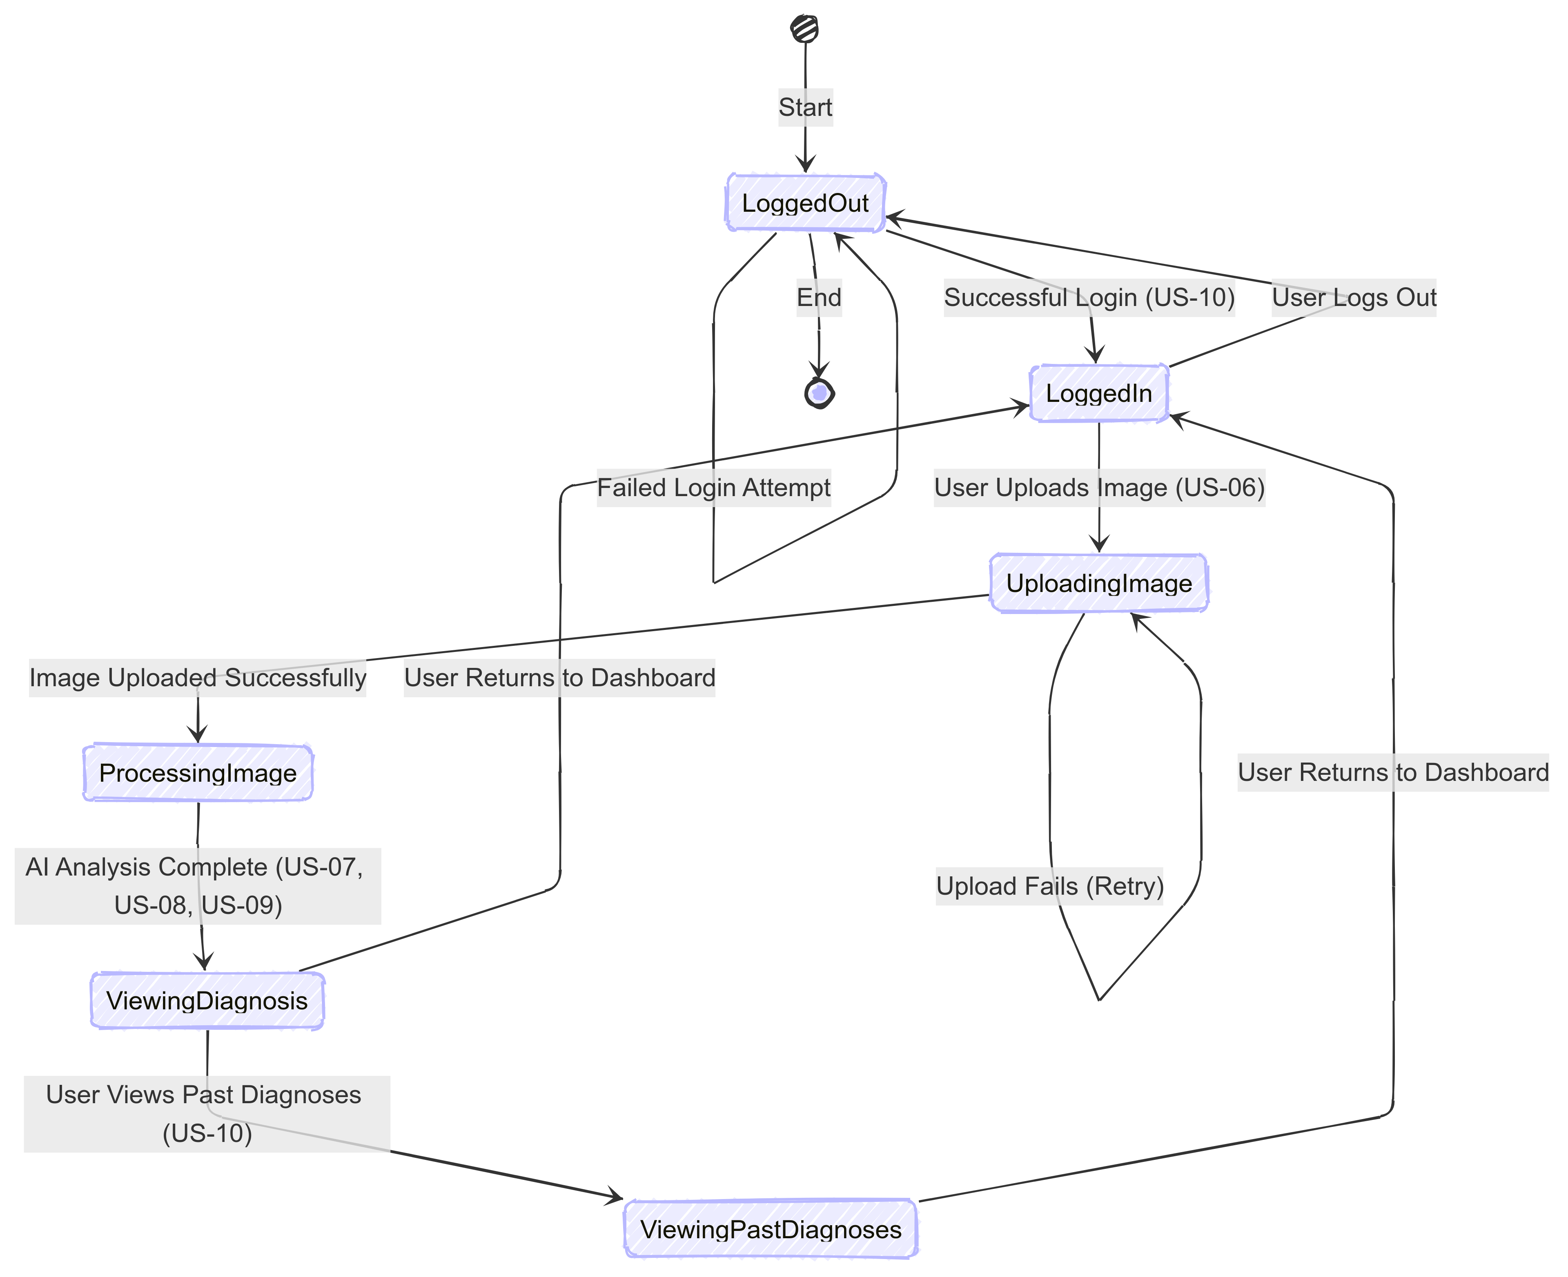
State diagram

Slide 21
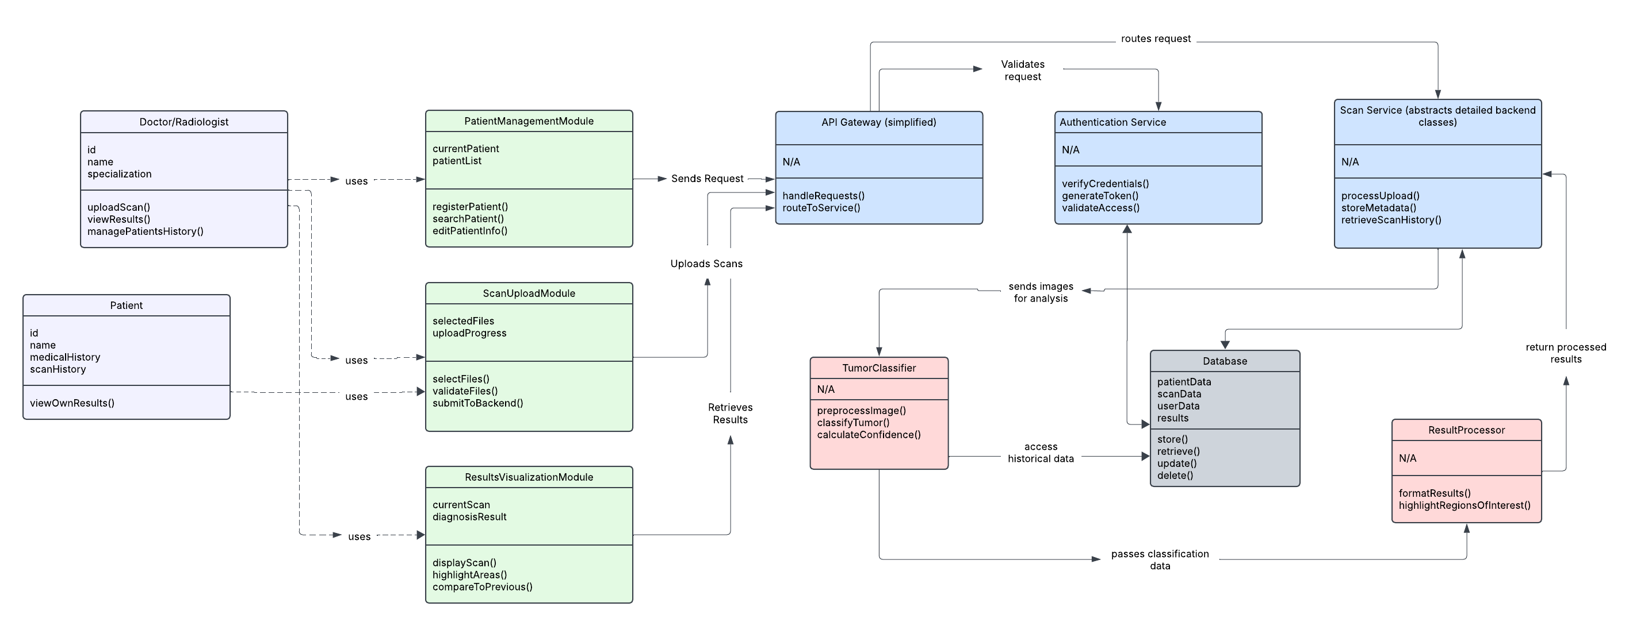
CLASS DIAGRAM

Slide 22
Product Backlog
ID | Sprint | User Story / Technical Story (TS) | Acceptance Criteria | Story Points (SP)
US-01 | Sprint 1 | As a visitor, I want a visually appealing landing page so I can understand the system at a glance. | - Page includes: header, project description, call-to-action button, and demo preview section. - Styling is consistent and visually engaging. - Page renders correctly on desktop and mobile browsers. | 3
US-02 | Sprint 1 | As a doctor/patient, I want an intuitive navigation menu so I can easily access different sections of the website. | - Navbar includes working links to: Home, Upload, Results, and About. - Navbar is fixed and responsive on all devices. | 2
US-03 | Sprint 1 | As a patient, I want a simple image upload interface so I can easily upload my medical images. | - Upload button allows file selection. - Image preview shown after selection. - Frontend only; no backend submission required. | 3
US-04 | Sprint 1 | As a mobile user, I want a responsive design so I can access the site on mobile devices. | - All pages adjust layout for screen sizes (mobile, tablet, desktop). - No overlapping or broken UI components. | 2

Slide 23
Product Backlog
ID | Sprint | User Story / Technical Story (TS) | Acceptance Criteria | Story Points (SP)
US-05 | Sprint 1 | As a patient, I want to see a static results page so I understand how the diagnosis will be displayed. | - Results page includes placeholders for image, diagnosis summary, and doctor notes. - Static dummy data is displayed correctly. | 2
TS-01 | Sprint 1 | As a developer, I want to set up the frontend framework and project structure so that the development is scalable. | - React project is initialized. - Routing for all planned pages is configured. - Folder structure follows best practices. | 2
TS-02 | Sprint 1 | As a developer, I want to implement UI components for buttons, inputs, and cards. | - Reusable styled components (Button, Input, Card) are created. - Components are tested and documented. | 3
US-06 | Sprint 2 | As a doctor, I want to upload an image and get it processed so I can receive a diagnosis. | - User can select and upload images. - Image is stored in the backend database. - Upload confirmation shown. | 5

Slide 24
Product Backlog
ID | Sprint | User Story / Technical Story (TS) | Acceptance Criteria | Story Points (SP)
US-07 | Sprint 2 | As a doctor, I want my medical image to be analyzed automatically so I can receive a diagnosis. | - Uploaded image is sent to AI model. - Model returns a classification (e.g., Normal, Pneumonia, Tumor). - Backend handles processing. | 8
US-08 | Sprint 2 | As a patient, I want to see my diagnosis displayed clearly so I can understand the results. | - Diagnosis result is shown on a result page. - Diagnosis includes label and confidence score. - UI is readable and visually clean. | 3
US-09 | Sprint 2 | As a patient, I want my diagnosis results to be stored so I can access them later. | - Diagnosis results and images are saved in the database. - Patient ID is linked to diagnosis entries. | 5
US-10 | Sprint 2 | As a patient, I want basic account authentication so I can securely log in and access my past diagnoses. | - Users can register and log in. - Passwords are encrypted. - Auth token/session is implemented. - Authenticated users can access their data. | 5

Slide 25
Product Backlog
ID | Sprint | User Story / Technical Story (TS) | Acceptance Criteria | Story Points (SP)
TS-03 | Sprint 2 | As a developer, I want to set up a backend API for image processing so that the system can analyze uploaded images efficiently. | - Flask/Django API accepts image uploads. - Routes for upload and prediction exist. - Image is processed and response returned. | 8
TS-04 | Sprint 2 | As a developer, I want to connect the frontend with the backend API so that data flows seamlessly between the client and server. | - Frontend sends requests to backend API. - Data from API is shown on the frontend. - Error states are handled. | 5
US-11 | Sprint 3 | As a patient, I want my diagnosis report to be downloadable so I can share it with doctors. | - Diagnosis results can be exported as a downloadable PDF. - PDF includes patient info, image, diagnosis, and date. | 5
US-12 | Sprint 3 | As a patient, I want a faster processing time so I don’t have to wait long for results. | - AI model processes images in under 2 seconds. - Response time tested on at least 10 different inputs. | 8

Slide 26
Product Backlog
ID | Sprint | User Story / Technical Story (TS) | Acceptance Criteria | Story Points (SP)
US-13 | Sprint 3 | As a doctor, patient, or admin, I want role-based access (doctor, patient, admin) so I can have personalized features. | - Users have roles (doctor, patient, admin). - Role-based dashboards and permissions implemented. - Unauthorized access blocked. | 5
US-14 | Sprint 3 | As a patient, I want the system to be highly accurate so I can trust the diagnosis. | - AI model reaches ≥90% accuracy on validation set. - Accuracy is documented and verified through testing. | 8
US-15 | Sprint 3 | As a patient, I want to access the system online so I can use it from anywhere. | - Web app is deployed to a public server (e.g., Vercel, Heroku, AWS). - Site is accessible from any device. | 5
TS-05 | Sprint 3 | As a developer, I want to implement logging and error handling so that system failures can be monitored and resolved efficiently. | - System logs backend/frontend errors. - Admin receives error notifications or logs are stored for debugging. - Critical failures are caught and don't crash the app. | 3

Slide 27
Sprint 2 Backlog
ID | User Story / Task (TS) | Acceptance Criteria (AC) | Story Points (SP)
US-06 | As a doctor, I want to upload an image and get it processed so I can receive a diagnosis. | - User can select and upload images. - Image is stored in the backend database. - Upload confirmation shown. | 5
US-07 | As a doctor, I want my medical image to be analyzed automatically so I can receive a diagnosis. | - Uploaded image is sent to AI model. - Model returns a classification (e.g., Normal, Pneumonia, Tumor). - Backend handles processing. | 8
US-08 | As a doctor, I want to see my diagnosis displayed clearly so I can understand the results. | - Diagnosis result is shown on a result page. - Diagnosis includes label and confidence score. - UI is readable and visually clean. | 3
US-09 | As a patient, I want my diagnosis results to be stored so I can access them later. | - Diagnosis results and images are saved in the database. - Patient ID is linked to diagnosis entries. | 5
US-10 | As a admin, I want basic account authentication so I can securely log in and access my past diagnoses. | - Users can register and log in. - Passwords are encrypted. - Auth token/session is implemented. - Authenticated users can access their data. | 5

Slide 28
Sprint 2 Backlog
ID | User Story / Task (TS) | Acceptance Criteria (AC) | Story Points (SP)
US-03 | (Carried from Sprint 1) As a patient, I want a simple image upload interface so I can easily upload my medical images. | - Upload button allows file selection. - Image preview shown after selection. - Frontend only; no backend submission required. | 3
US-05 | (Carried from Sprint 1) As a doctor, I want to see a static results page so I understand how the diagnosis will be displayed. | - Results page includes placeholders for image, diagnosis summary, and doctor notes. - Static dummy data is displayed correctly. | 2
TS-03 | As a developer, I want to set up a backend API for image processing so that the system can analyze uploaded images efficiently. | - Flask/Django API accepts image uploads. - Routes for upload and prediction exist. - Image is processed and response returned. | 8
TS-04 | As a developer, I want to connect the frontend with the backend API so that data flows seamlessly between the client and server. | - Frontend sends requests to backend API. - Data from API is shown on the frontend. - Error states are handled. | 5

Slide 29
Sprint 2 test cases
ID | Test Case Description | Expected Result | Actual Result | Pass/Fail
US-06-TC01 | Verify that a user can upload an image via the interface | User selects an image file, clicks upload, and the image is successfully stored in the database with a preview displayed. | Image uploaded and stored in the database; preview displayed correctly. | Pass
US-03-TC01 | Verify image preview displays correctly after upload | After selecting an image, a preview of the image appears on the interface before submission. | Preview of the selected image appeared correctly on the interface. | Pass
US-07-TC01 | Verify that an uploaded lung X-ray is analyzed by the AI model | User uploads a lung X-ray, and the system returns a classification (e.g., "Normal" or "Pneumonia"). | Lung X-ray uploaded; system returned "Normal" classification. | Pass
US-07-TC02 | Verify that an uploaded brain MRI is analyzed by the AI model | User uploads a brain MRI, and the system returns a classification (e.g., "Normal" or "Tumor"). | Brain MRI uploaded; system returned "Normal" classification. | Pass
US-08-TC01 | Verify that mock diagnosis results are displayed clearly on the frontend | After analysis, the diagnosis (e.g., "Normal" or "Disease Detected") is shown in a readable format on the UI. | Diagnosis "Normal" displayed clearly in a readable format on the UI. | Pass
US-09-TC01 | Verify that diagnosis results are stored in the database | After analysis, the diagnosis and image metadata are retrievable from the database. | Diagnosis and metadata stored and retrievable from the database. | Pass
US-10-TC01 | Verify that a user can sign up for an account | User enters valid credentials (e.g., email, password), submits, and receives a success message; account is created. | User signed up with valid credentials; success message received. | Pass

Slide 30
Sprint 2 test cases
ID | Test Case Description | Expected Result | Actual Result | Pass/Fail
US-10-TC02 | Verify that a user can log in with valid credentials | User enters correct email/password, clicks login, and is redirected to their dashboard with past diagnoses. | User logged in and redirected to dashboard; past diagnoses visible. | Pass
US-10-TC03 | Verify that a user cannot log in with invalid credentials | User enters incorrect email/password, clicks login, and receives an error message (e.g., "Invalid credentials"). | Login failed with incorrect credentials; "Invalid credentials" error shown. | Pass
US-10-TC04 | Verify that past diagnoses are accessible after login | After logging in, the user sees a list of previously stored diagnoses linked to their account. | User logged in; list of past diagnoses displayed correctly. | Pass
US-05-TC01 | Verify static results page UI styling is correct | The static results page displays with proper alignment, fonts, and colors as per design specs. | Static results page displayed with correct alignment, fonts, and colors. | Pass
TS-03-TC01 | Verify backend API accepts and processes an image upload | Developer sends a POST request with an image to the API, and the API returns a 200 status with analysis results. | API returned 200 status with analysis results for the uploaded image. | Pass
TS-04-TC01 | Verify frontend sends image data to backend API successfully | User uploads an image via the frontend, and the backend API receives and processes it without errors. | Frontend sent image data; backend processed it without errors. | Pass
US-06-TC02 | Verify end-to-end flow: upload, analysis, and display | User uploads an image, the backend processes it, and the frontend displays the diagnosis seamlessly. | Image uploaded, processed by backend, and diagnosis displayed seamlessly. | Pass

Slide 31
Sprint 2 Stories completed
ID | User Story / Task (TS) |  | Story Points (SP)
US-03 | (Carried from Sprint 1) As a doctor/patient, I want a simple image upload interface so I can easily upload my medical images. |  | 3
US-05 | (Carried from Sprint 1) As a doctor/patient, I want to see a static results page so I understand how the diagnosis will be displayed. |  | 2
US-06 | As a doctor, I want to upload an image and get it processed so I can receive a diagnosis. |  | 5
US-07 | As a doctor, I want my medical image to be analyzed automatically so I can receive a diagnosis. |  | 8
US-08 | As a patient, I want to see my diagnosis displayed clearly so I can understand the results. |  | 3
US-09 | As a patient, I want my diagnosis results to be stored so I can access them later. |  | 5
US-10 | As a doctor/patient, I want basic account authentication so I can securely log in and access my past diagnoses. |  | 5
TS-03 | As a developer, I want to set up a backend API for image processing so that the system can analyze uploaded images efficiently. |  | 8
TS-04 | As a developer, I want to connect the frontend with the backend API so that data flows seamlessly between the client and server. |  | 5

Slide 32
Metrics
Team Velocity
Total Story Points Completed: 44 SP
Team Velocity: 44 SP
Completed/Committed Ratio
Total Story Points Committed: 44 SP
Total Story Points Completed: 44 SP
Completed/Committed Ratio: (44/44) = 100%
Average Completed/Committed Ratio: Sprint 1: 70.59%
Sprint 2: 100%
Average = (70.59 + 100) / 2 = 85.29%

Slide 33
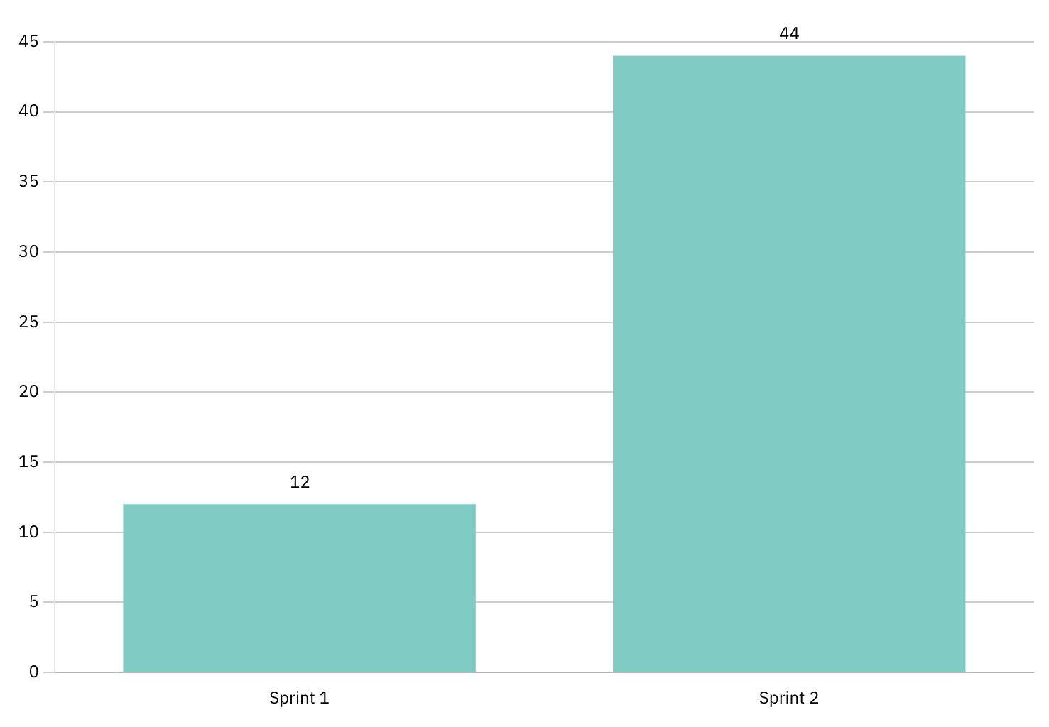
HISTORICAL TEAM VELOCITY

Slide 34
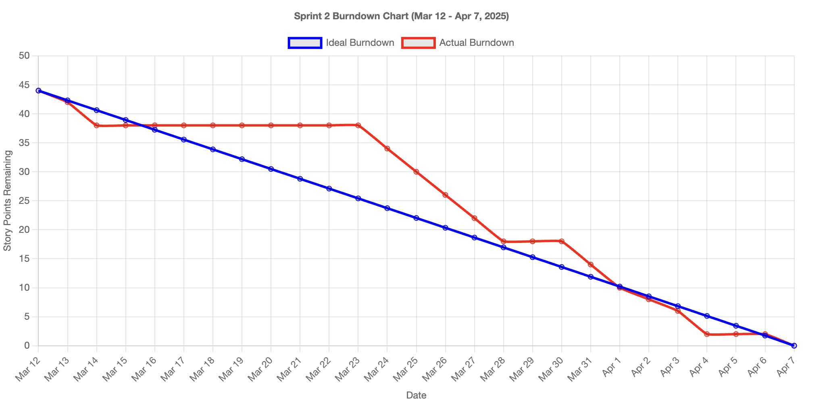
BURNDOWN CHART

Slide 35
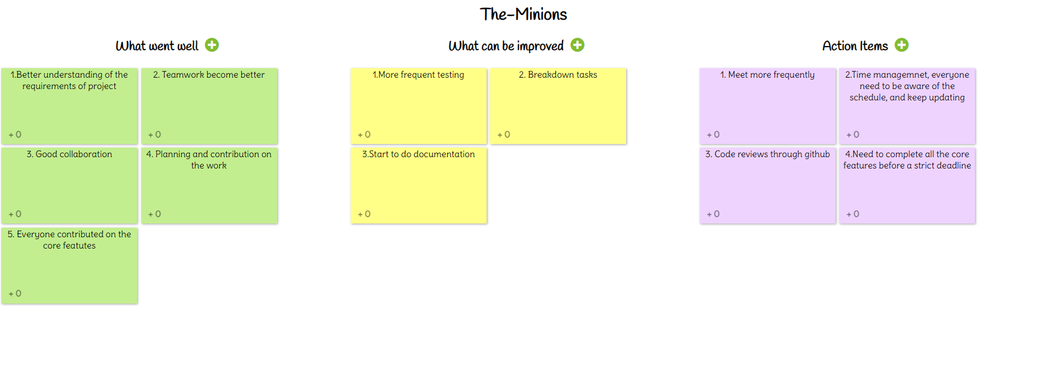
rETROSPECTIVE

Slide 36
Sprint 3 planning
ID | Sprint | User Story / Technical Story (TS) | Acceptance Criteria | Story Points (SP)
US-11 | Sprint 3 | As a patient, I want my diagnosis report to be downloadable so I can share it with doctors. | - Diagnosis results can be exported as a downloadable PDF. - PDF includes patient info, image, diagnosis, and date. | 5
US-12 | Sprint 3 | As a researcher, I want a faster processing time so I don’t have to wait long for results. | - AI model processes images in under 2 seconds. - Response time tested on at least 10 different inputs. | 8
US-13 | Sprint 3 | As a system admin, I want role-based access (doctor, patient, admin) so I can have personalized features. | - Users have roles (doctor, patient, admin). - Role-based dashboards and permissions implemented. - Unauthorized access blocked. | 5
US-14 | Sprint 3 | As a doctor, I want the system to be highly accurate so I can trust the diagnosis. | - AI model reaches ≥90% accuracy on validation set. - Accuracy is documented and verified through testing. | 8
US-15 | Sprint 3 | As a patient, I want to access the system online so I can use it from anywhere. | - Web app is deployed to a public server (e.g., Vercel, Heroku, AWS). - Site is accessible from any device. | 5
TS-05 | Sprint 3 | As a developer, I want to implement logging and error handling so that system failures can be monitored and resolved efficiently. | - System logs backend/frontend errors. - Admin receives error notifications or logs are stored for debugging. - Critical failures are caught and don't crash the app. | 3

Slide 37
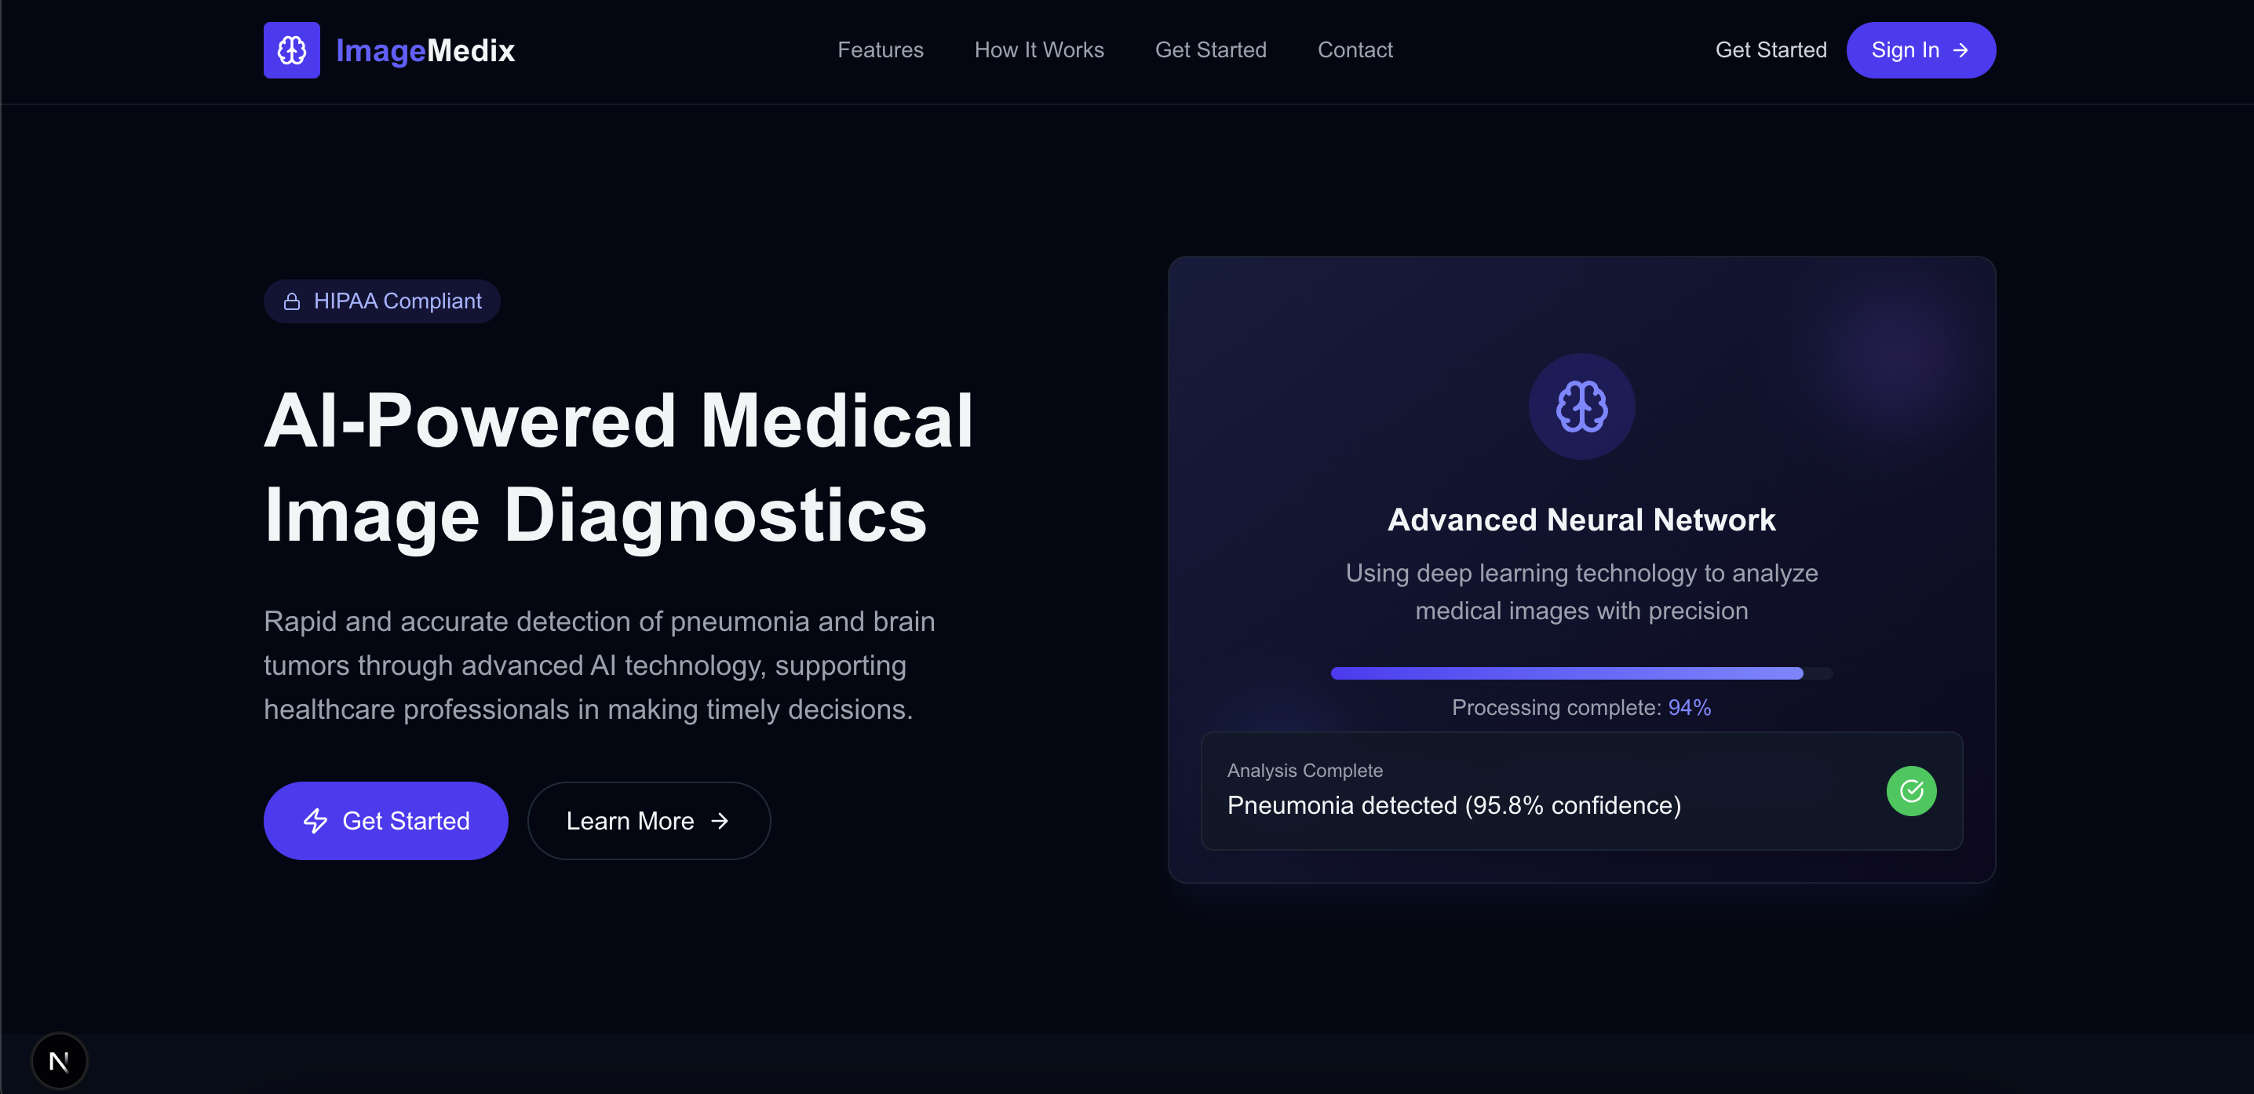
Application SCreenshots

Slide 38
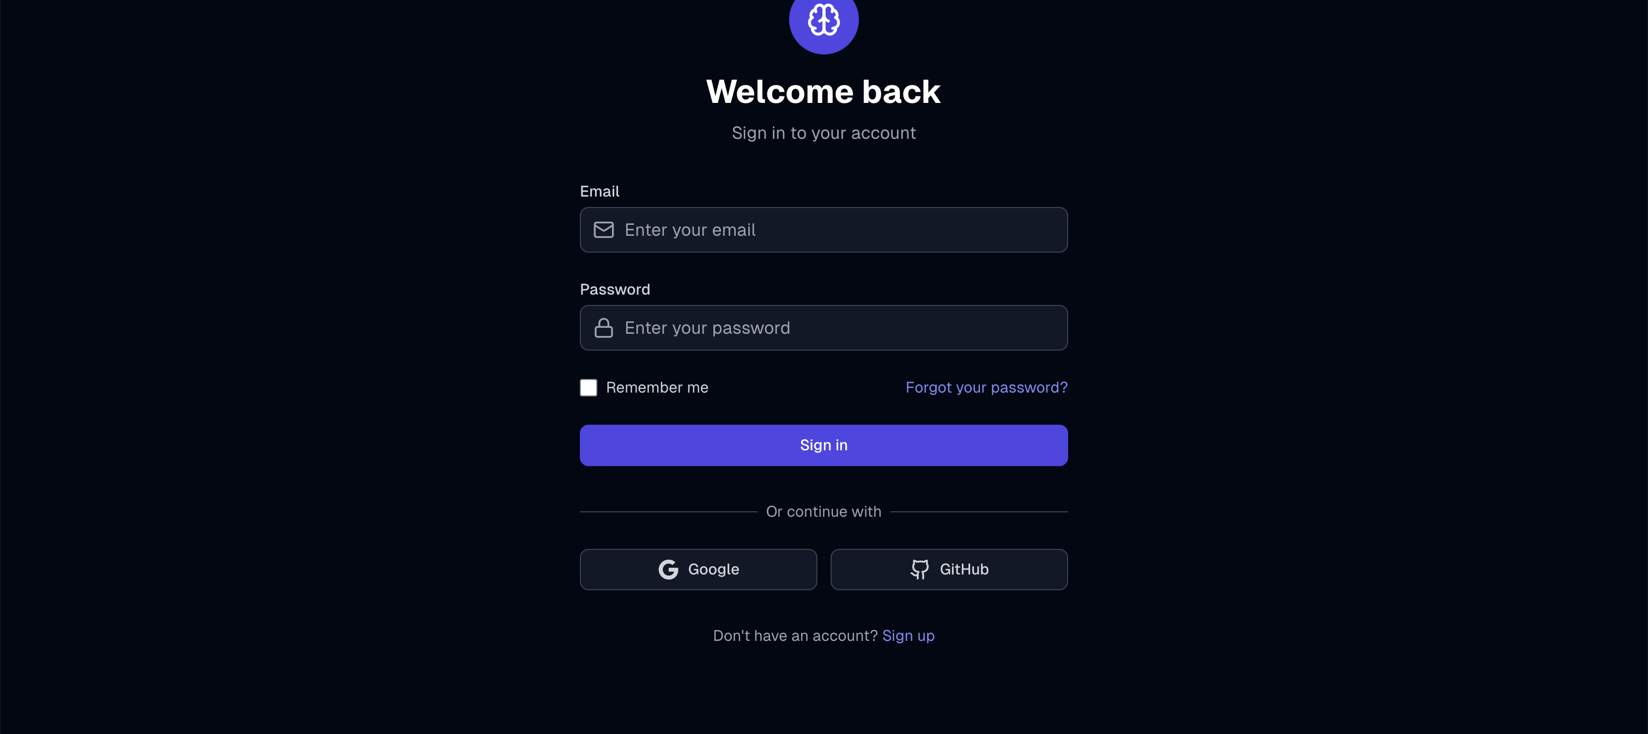

Slide 39
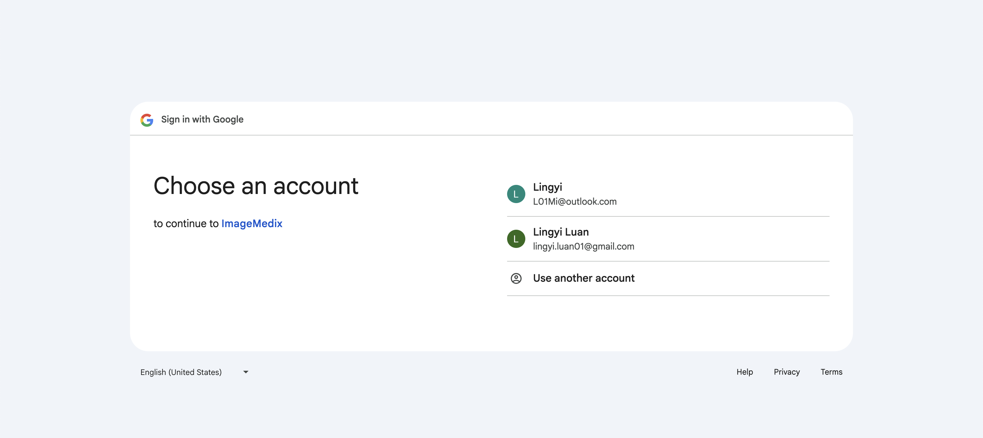

Slide 40
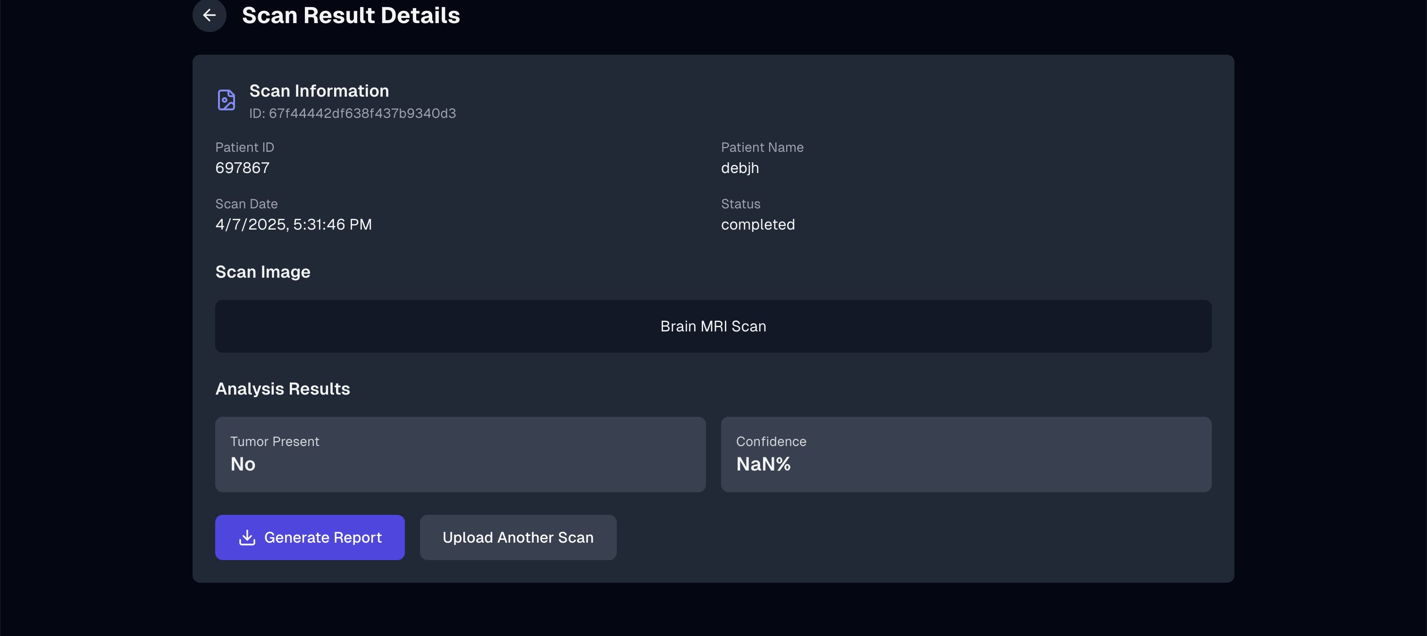

Slide 41
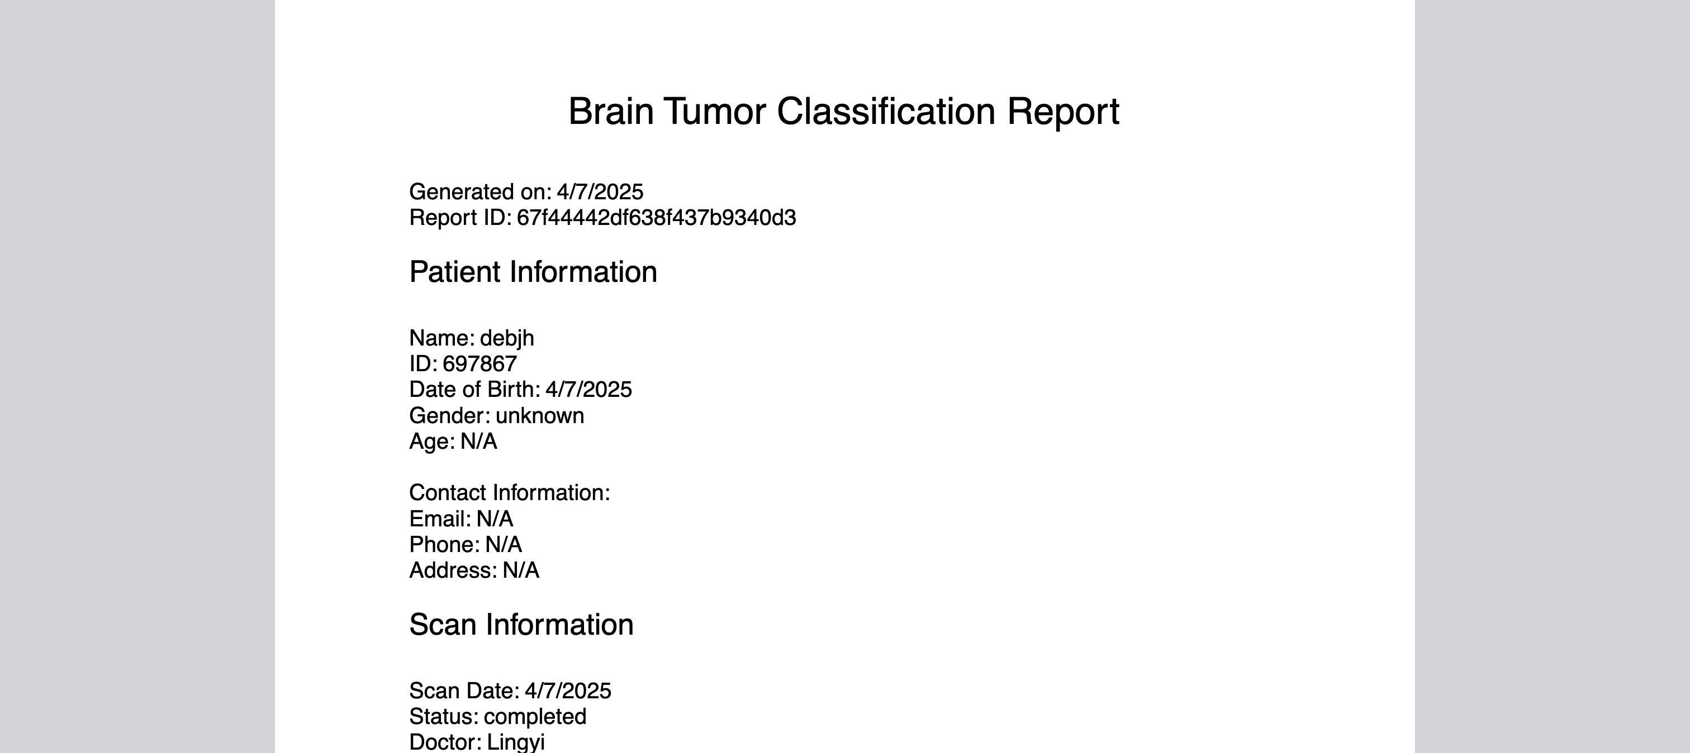

Slide 42
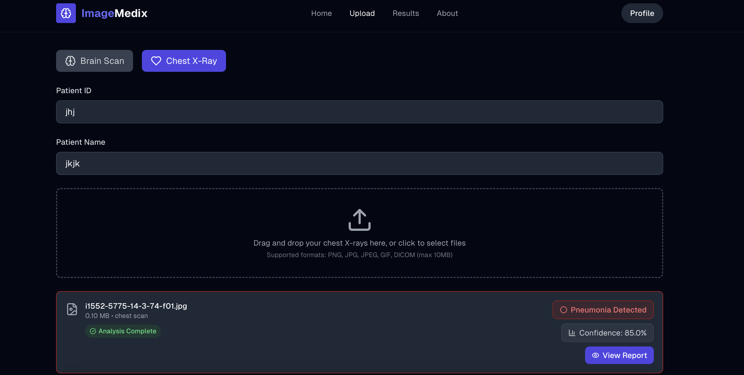

Slide 43
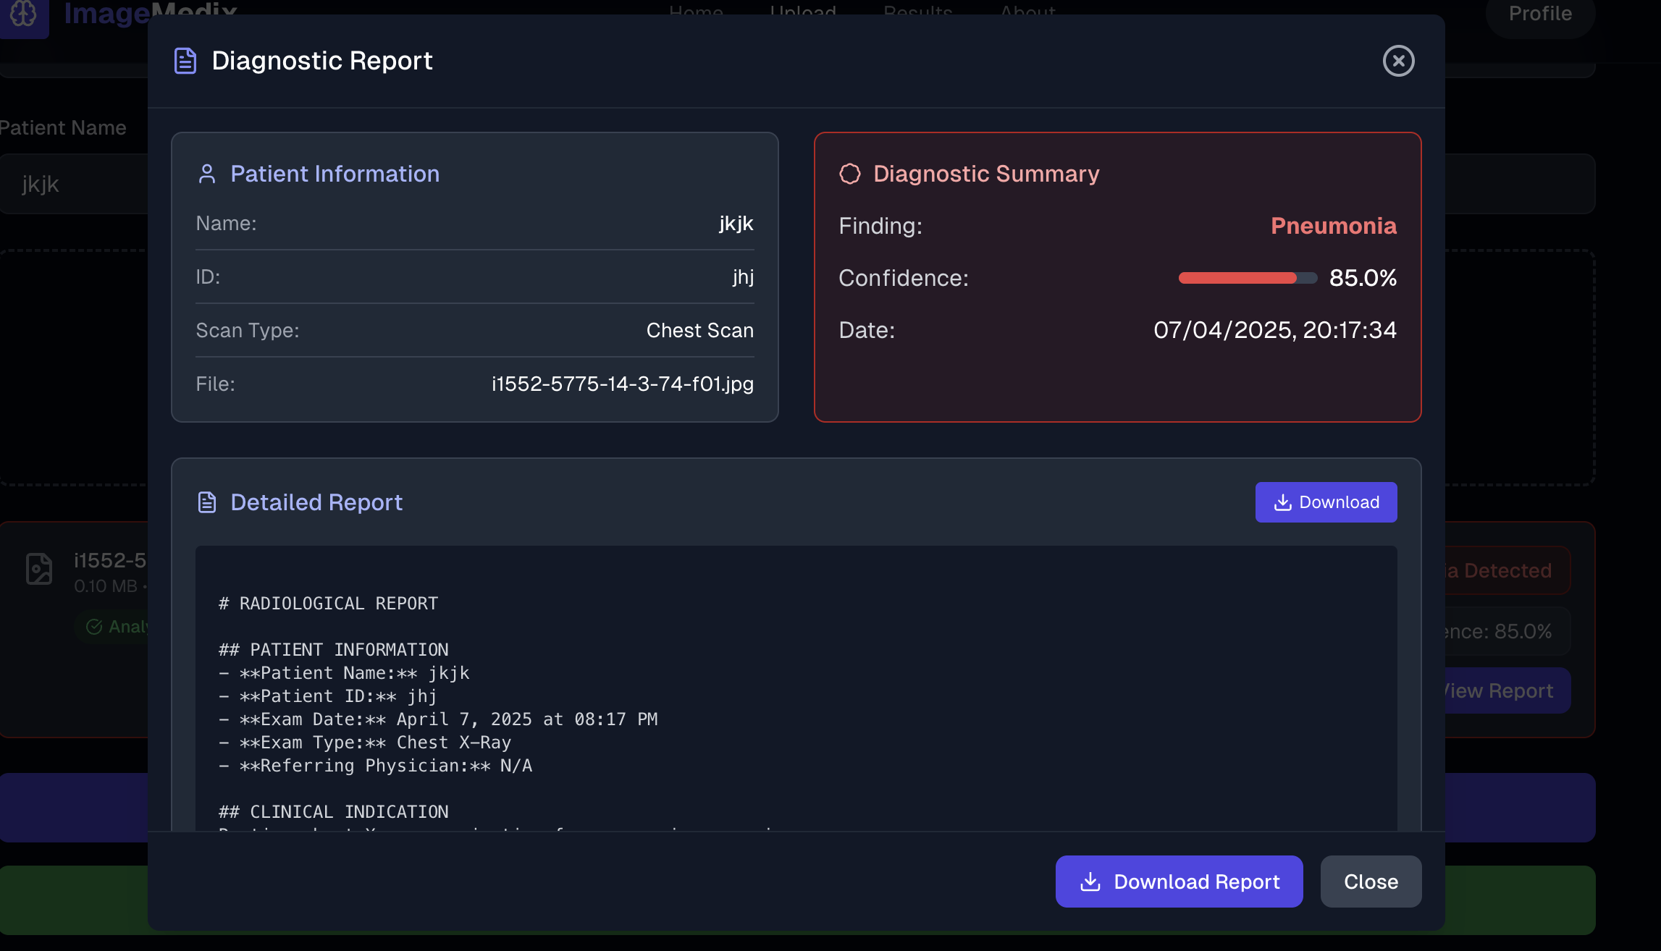

Slide 44
Wikipage linK
https://github.com/htmw/2025S-The-Minions/wiki

Slide 45
Application Demo

Slide 46
tHANK YOU

